Slide 1
캡스톤 디자인 03분반 M조
제스쳐 인식을 통한 기기 제어
20174188 김형균
20174299 이성준
20195134 장시원
20195135 김범수

Slide 2
Contents
1
Progress
2
Plan
3
Q & A

Slide 3

Part 1,
Progress

Slide 4
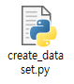
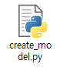
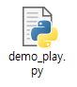
Part 1,
Progress
Program Process
Collect Data
Create Model
Program
Use the webcam to recognize the gestuer to be assigned to system behavior and store the data set
Create a model using stored data sets in the data collection phase
Compare recognized gesture by the webcam to the model that generated. And operate the specified command
>>
>>

Slide 5
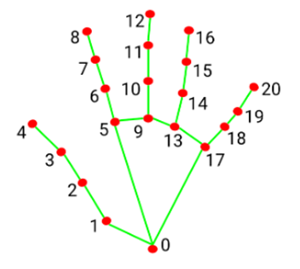
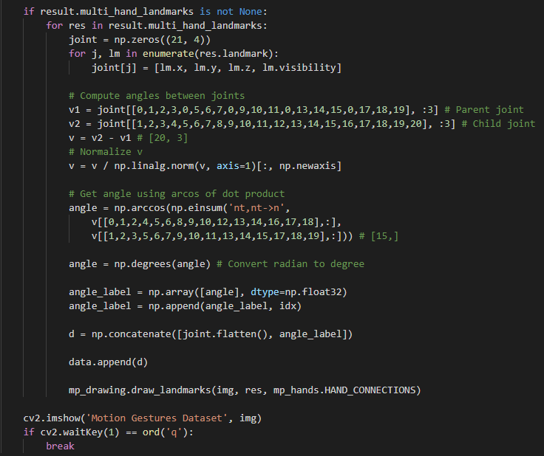
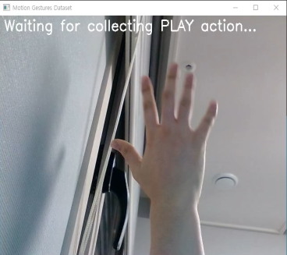
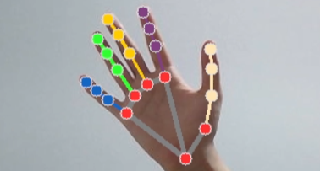
Part 1,
Progress
Create Dataset - Code

Slide 6

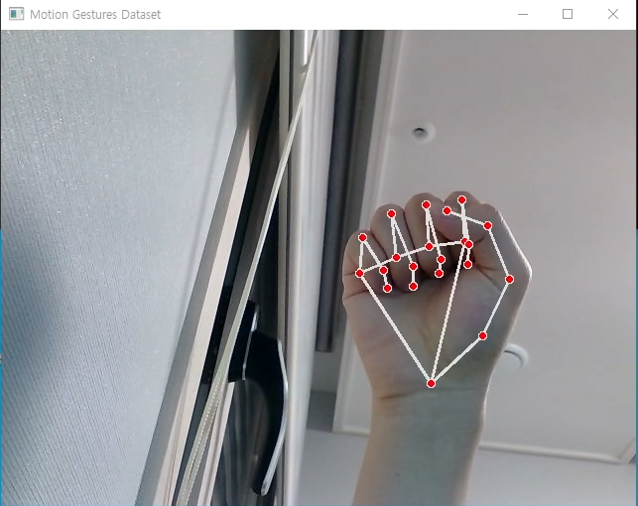
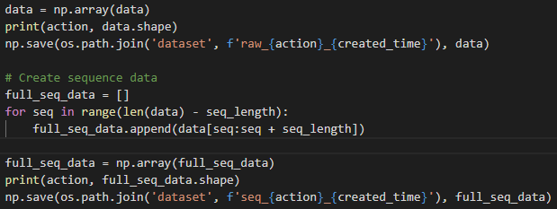
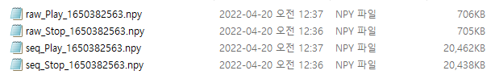
Part 1,
Progress
Create Dataset - Process
인식 대기
동작 인식

Slide 7
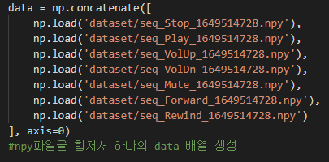
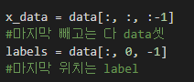
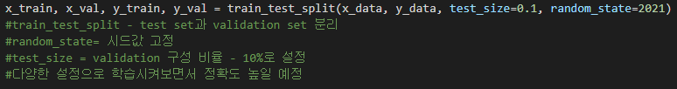
Part 1,
Progress
Create Model – Code
Word | Index | One – hot vector
Stop | 0 | [1,0,0,0,0,0,0]
Play | 1 | [0,1,0,0,0,0,0]
VolUp | 2 | [0,0,1,0,0,0,0]
VolDn | 3 | [0,0,0,1,0,0,0]
Mute | 4 | [0,0,0,0,1,0,0]
Forard | 5 | [0,0,0,0,0,1,0]
Rewind | 6 | [0,0,0,0,0,0,1]
Ex) One hot encording

Slide 8
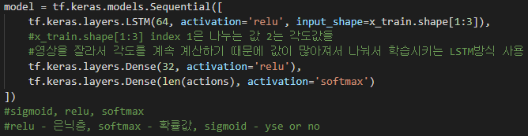
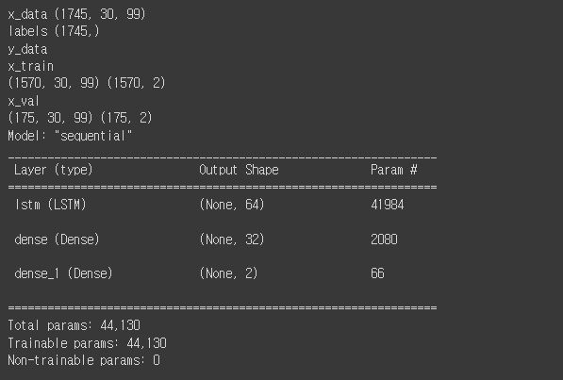
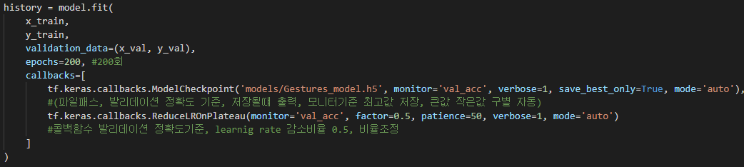
Part 1,
Progress
Create Model – Code

Slide 9
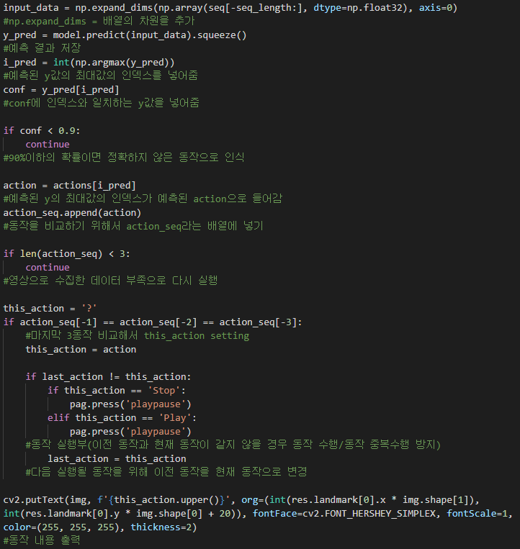
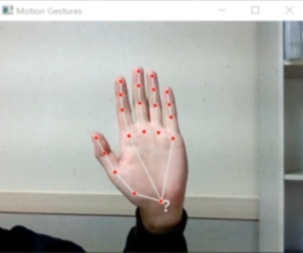
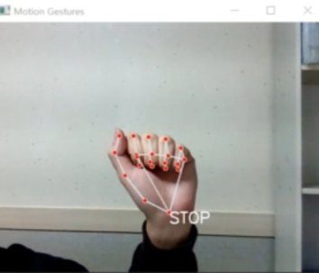
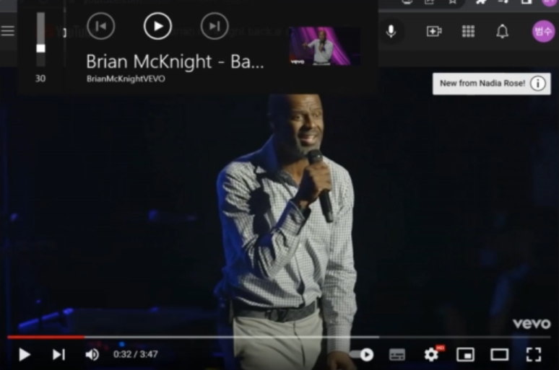
Part 1,
Progress
Demo Play - Code
대기상태
동작인식

Slide 10
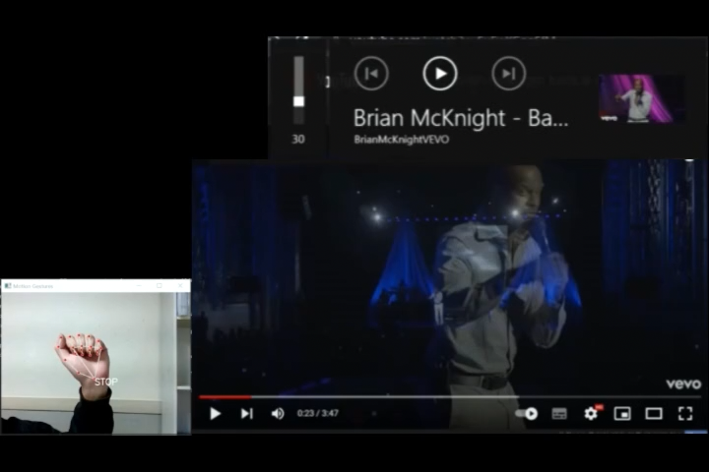
Part 1,
Progress
Demo Play

Slide 11

Part 2,
Plan

Slide 12


Part 2,
Plan
Considerations
Improvements
Additional function

Slide 13
Part 2,
Plan
Improvements
Uncomfortable use
Low Accuracy Models
Low-accuracy gesture recognition

Slide 14
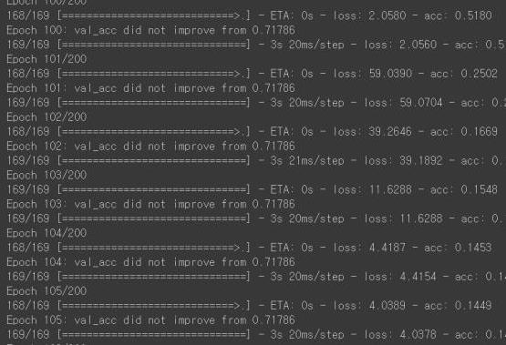
Part 2,
Plan
Improvements
Low Accuracy Models
Low-accuracy gesture recognition

Slide 15
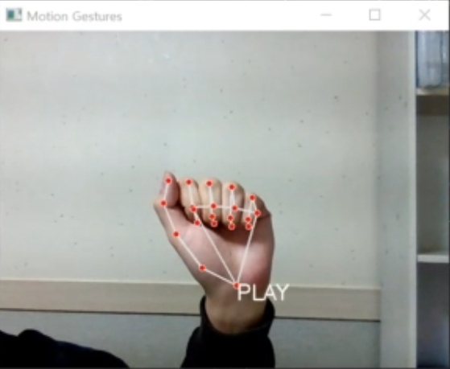
Part 2,
Plan
Improvements
Low-accuracy gesture recognition

Slide 16
Part 2,
Plan
Improvements
Additional function
GUI implement
Find specific programs (Youtube or Netflix, etc.)
Additional function

Slide 17
Part 2,
Plan
Additional function
GUI implement
Find specific programs (Youtube or Netflix, etc.)
Additional function

Slide 18
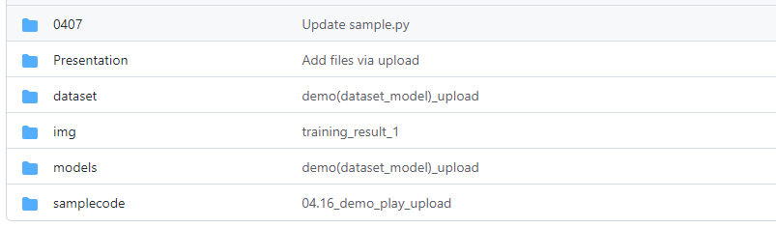
Reference, Github
모션 인식 참고 소스 코드 - https://github.com/kairess/gesture-recognition
캡스톤 디자인 M조, Github 주소 - https://github.com/devel0624/Capstone-Design-Team-M
PPT 템플릿, 새별 블로그 - https://blog.naver.com/seiru523

Slide 19
Q&A

